Slide 1
CONGENITAL HEART DISEASES
SIMIYU NANJALA SYLVIA

Slide 2
ANATOMY AND PHYSIOLOGY OF THE HEART
The human heart

Slide 3
ANATOMY AND PHYSIOLOGY OF THE HEART
Foramen ovale- connects the right and left atrium during fetal life
Ductus arteriosus- connects the pulmonary artery and aorta during fetal life

Slide 4
Etiology of congenital heart diseases
Maternal infections- herpes simplex in 1st trimester
Maternal medication- thalidomide (immunosuppressant)
Heredity- one sibling is likely to be affected if there are some who are already affected
Genetic factors- gargoylism, Marfan Syndrome
Environmental factors- pollution

Slide 5
Classification of congenital heart diseases.
1. Acyanotic congenital heart diseases. (Left to right shunting). S & S of acyanotic CHDs
Frequent chest infection- bronchopneumonia
Tachypnea
No cyanosis
Prone to CCF- xtised by sweating
Precordial bulge
Hyperkinetic precordium on palpation
Tricuspid/ mitral delayed diastolic murmur
CXR- cardiomegaly & plethoric lung fields

Slide 6
Classification of acyanotic CHDs
Ventricular septal defect
Artrial septal defect
Patent ductus arteriosus

Slide 7
Ventricular septal defect (VSD)
Most common acyanotic CHD- 25% of all CHDs.
There’s a hole connecting right and left ventricle.
Left to right shunt develops due to high pressure in left ventricle.
Restrictive VSD (<0.5cm2) – small left to right shunting
Non-restrictive VSD (over 1cm2) – large left to right shunting- more symptomatic

Slide 8
VSD
Large defects are associated with recurrent chest infections
Cardiomegaly on CXR
Murmur- loud pan-systolic heard at 3rd, 4th and 5th ICS, accompanied by a thrill.
Pulmonary HTN
In older children- wide pulse pressure

Slide 9
Diagnosis of VSD
CXR- minimal cardiomegaly and slightly increased pulmonary vascularity
ECG- normal. In large defects, peaked P waves

Slide 10
Treatment of VSD
Good nutrition with treatment of iron deficiency anemia
Antibiotic prophylaxis for endocarditis
Corrective surgery before 2 years of age

Slide 11
Artrial septal defect. (ASD)
An abnormal opening in the wall (septum) that divides the two upper chambers of the heart (atria).
There is left to right shunting.
Since the left side of the heart is at a higher pressure than the right side, blood from the left atrium will flow to the right atrium and subsequently back to the lungs

Slide 12
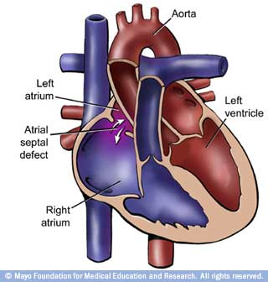
ASD

Slide 13
Signs and symptoms of ASD
ASD signs and symptoms depend on its size and the amount of blood flows that flows abnormally across the defect. Symptoms may include:
Breathing difficulties
Enlarged heart
Irregularities in heart rhythm (dysrhythmias), especially atrial dysrhythmias
Heart failure
Atrial septal defect closure is the surgical procedure for ASD

Slide 14
ASD
Normally, the shunting will not cause cyanosis. However, because the right side of the heart and the blood vessels in the lungs are not built to withstand increased volumes and pressures, left-to-right shunting may result in heart failure and heart arrhythmias.

Slide 15
Diagnosis of an ASD.
CXR- right atrial and ventricular enlargement, increased pulmonary vascularity, enlarged PA, smaller left ventricle and aorta
ECG- right ventricular hypertrophy and right axis deviation
Echocardiogram- right ventricular overload
Cardiac catheterization- highly oxygenated blood in right atrium than in the left atrium

Slide 16
Management of an ASD
Manage CCF and arrhythmias medically
Antibiotic prophylaxis during dental procedures
Open heart surgery for closure f defect. Done in childhood

Slide 17
Patent ductus arteriosus
Occurs as an isolated defect, unlike other CHDs
Occurs as twice in girls as in boys.

Slide 18
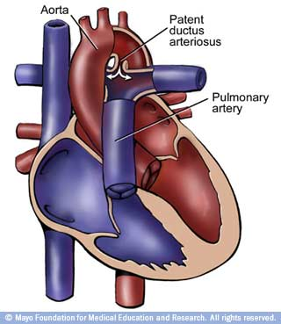
PDA

Slide 19
Pathophysiology of PDA
Magnitude of the shunting depends on the size of ductus arteriosus
The shunt is from the aorta to pulmonary artery due to high pressures in the aorta.
In extreme cases, pulmonary hypertension occurs
If untreated- pulmonary vascular disease may develop.

Slide 20
S & S of PDA
Growth retardation
Exertional dyspnea
Left ventricular failure
CCF
Precordial pain and hoarseness- due to laryngeal nerve involvement
Classical heart murmur, usually accompanied by a thrill

Slide 21
Complications of PDA
CCF
Infective endocarditis
Aneurysmal dilatation of pulmonary artery
Thromboembolism
Rheumatic heart disease

Slide 22
Diagnosis of PDA
CXR- cardiomegaly
ECG- normal but may show ventricular hypertrophy with deep q waves in the ventricular leads
Echocardiogram- normal in small PDA. In large PDA- increase in left atrial and ventricular dimensions
Cardiac catheterization- presence of oxygenated blood in PA and normal or raised pressure in RV & PA

Slide 23
Management of PDA
Natural closure of PDA before 1st birthday
Asymptomatic PDA- surgery through ligation/ division of the ductus btn 3-10 yrs
Medical management- managing CCF, prevention and treatment of infective endocarditis
Use of antiprostaglandin agents- aspirin, indomethacin, mefanemic acid, help in closure.

Slide 24
2. Cyanotic CHDs
With decreased pulmonary blood flow
Cyanosis with polycythemia
Moderate to severe cyanosis
Irreversible pulmonary arterial HTN
Poor prognosis
Tetralogy of Fallot
Tricuspid atresia
Transposition of great vessels

Slide 25
Cyanotic CHDs
B. with increased pulmonary blood flow
The child is just usually slightly cyanosed
Example is:
Persistent truncus arteriosus
(student to read for themselves)

Slide 26
Tetralogy of Fallot (TOF)
This defect is a combination of four (Tetralogy) congenital abnormalities.
The four defects usually result in an insufficient amount of oxygenated blood reaching the body

Slide 27
TOF
Ventricular septal defect (VSD): An abnormal opening between the two lower chambers of the heart
Pulmonic stenosis (PS): A narrowed area within the main pulmonary artery, at, above or below the pulmonary valve
Malpositioned aorta: The entrance to the aorta overrides the VSD
Ventricular hypertrophy: An overly muscular right ventricle

Slide 28
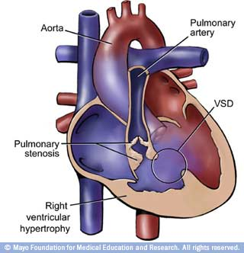
TOF

Slide 29
TOF
Complications of Tetralogy of Fallot include cyanosis — "blue baby syndrome," since the lips, fingers and toes may have a bluish tinge from lack of oxygen.
These children also have poor eating, inability to tolerate exercise, arrhythmias, delayed growth and development. Surgical repair of the defects is required early in life

Slide 30
TOF
Clinical features become evident after the closure of the ductus arteriosus
Cyanotic spell- occur due to insufficcient oxygen in systemic blood. Xtised by dyspnea, cyanosis with/ without loss of conciousness
Cyanotic spell is relieved by having child in sqautting posiition- increases peripheral vascular resistance

Slide 31
TOF
Murmurs may be present – loud, short systolic at left sternal border in the 3rd intercostal space.
Diagnosis-
Complete blood count- polycythemia, high hematocrit
CXR- oligemic lung fields, small boot shaped heart
ECG- right axis deviation RV hypertrophy
Cardiac catheterization & selective angiocardiography- show the anatomic anomalies

Slide 32
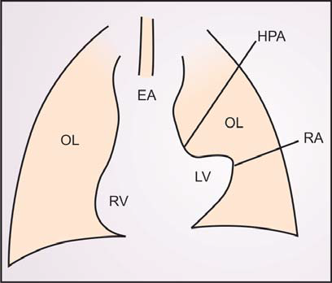
TOF- CXR
EA-Enlarged aorta RA-Raised apex
RV-Right ventricle OL-Oligemic lung
HPA-Hypoplastic LV-Left ventricle
pulmonary artery

Slide 33
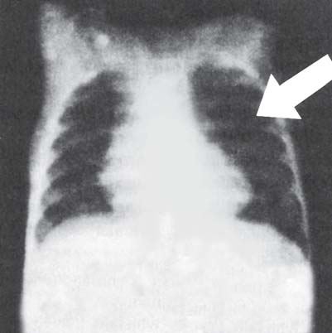
TOF- CXR

Slide 34
Treatment- TOF
Surgical management to correct defect- definitive treatment- open heart surgery
General measures- correct iron deficiency anemia, correct dehydration, antibiotic prophylaxis
Management of spells

Slide 35
Management of TOF Cyanotic Spells
Comfort the child and place in knee-chest position.
Administer humidified O2 by face mask
Give morphine, 0.1-0.2 mg/kg. (IV)
Begin IV fluid replacement and volume expansion (if child
is anemic, administer blood)
Treat acidosis with sodium bicarbonates
Administer propranolol, 0.1 to 0.2 mg/kg (IV)
Increase systemic vascular resistance by IV administration
of vaso-pressors like methoxamine or phenylephrine.
Titrate dose to increase systemic systolic blood pressure
by 20%. In no case this step should be allowed to postpone
surgical intervention
Operate to repair defect or to establish systemic-to pulmonary
artery anastomosis

Slide 36
Cyanotic CHD
B. With increased pulmonary blood flow
Slight cyanosis
Transposition of great vessels
Persistent ductus arteriosus

Slide 37
Transposition of great arteries (TGA)
Most common cause of mortalities
Four times more common in males than in females
The PA and the aorta have eexhanged psitions.
PA carries oxygenated blood to lungs then back to heart through PV
The aorta carries deoxygenated blood from heart to the systemic circuation then back to heart through VC

Slide 38
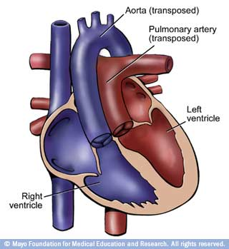
TGA

Slide 39
TGA
There are two different circuits of blood.
Deoxygenated blood is not getting oxygenated and oxygenated blood is not being circulated in the periphery for utilization.
The child is cyanosed

Slide 40
Diagnostic studies for TGA
CXR- cardiomegaly
ECG- Right ventricular hypertrophy
Cardiac catheterization and selective angiography- to confirm diagnosis

Slide 41
Treatment for TGA
IV prostaglandins to maintain ductus arteriosus patent.
Diuretics
Iron supplements
Beffe’s operation- vena caval anastomosis to left atrium and pulmonary vein to right atrium.

Slide 42
Tricuspid atresia
Refers to general absence of tricuspid valve thus absence in outlet from RA to RV.
The entire systemic venous return , therefore enters the left heart through the foramen ovale or an ASD.

Slide 43
Tricuspid atresia
There’s mixing of deoxygenated and oxygenated blood i.e. systemic venous blood and pulmonary venous blood respectively
From LA, mixed blood goes to LV.
Management- more as for TOF
Also, an aorto-pulmonary shunt may be done (due to decreased pulmonary blood flow)

Slide 44
3. Obstructive CHDs
Right sided
Pulmonary stenosis
b) Left sided
Coarctation of the aorta
Congenital aortic stenosis
Vascular rings
Anomalous origin of coronary arteries
Congenital mitral stenosis
Dextrocardia

Slide 45
Coarctation of the aorta
Coarctation – constriction
3 times as common in males as compared to females
Postductal and preductal coarctation.
Postductal coarctation- occurs after the 3 arterial branches from the aortic arch
Preductal coarctation occurs at a point before the arterial branchings at the aortic arch

Slide 46
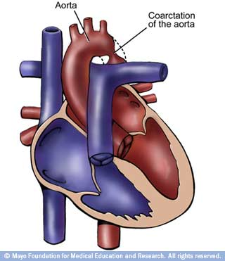
Coarctation of the aorta

Slide 47
S & S of Coarctation of the aorta
Pre-ductal
Difficulty in feeding
Dyspnea
Failure to thrive
Pitting edema
Heart murmurs
Post-ductal
Fatigue
Muscle cramps
Intermittent claudication
Headache
Weakness
Exertional dyspnea
Overgrowth of upper body

Slide 48
Management
Surgery

Slide 49
Aortic stenosis
The aortic valve (at the base of the aorta) is abnormally narrowed.
Can be subaortic/ subvalvular, valvular, or supravalvular
The stenosis leads to increased volume and pressures in the LV, leading to elevated SBP

Slide 50
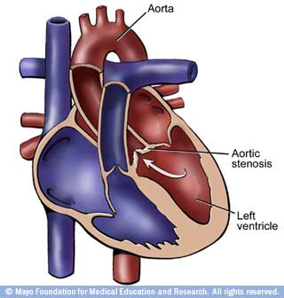
Aortic stenosis

Slide 51
S & S of aortic stenosis
Easy fatigability
Exercise intolerance
Dizziness
Syncope

Slide 52
Aortic stenosis
Diagnosis: CXR- prominent left hypertrophy of the heart, echocardiography
Treatment- surgery- aortic valvotomy or aortic valve replacement

Slide 53
Hypoplastic left heart syndrome
Hypoplasia of LV due to obstructive lesions
CCF develops within a few days
CXR shows cardiomegaly
Echocardiogram- poorly defined mitral valve
Death occurs as a complication

Slide 54
Pulmonary valve stenosis
Flow of blood from the right ventricle to the pulmonary artery is obstructed by narrowing at the pulmonary valve.
The right ventricle must pump harder to get blood into the pulmonary artery.
Defect may occur along with other defects, such as thickening of the muscle of the right ventricle immediately below the valve

Slide 55
Pulmonary stenosis
In many cases a balloon (pulmonary valvuloplasty) can be used to relieve the stenosis. In some cases, especially patients with other heart defects, surgery may be necessary to replace the valve

Slide 56
Thank you
Read on the other conditions not discussed in the slides

